Slide 1
classified ads for open educational resources
Sara Frank Bristow | Salient Research | @salientresearch
#OER14 | Newcastle, UK |29 April 2014

Slide 2
Who’s here?

Slide 3
“What is OER?”
“I’d use OER in my classroom, but I don’t know where to find it.”
“How do I know if it’s any good?”

Slide 4
Where do people talk about OER?

Slide 5
Survey
results:
How
do we
share
info
about
OER?

Slide 6
Not really creating an “OER footprint” for other users

Slide 7
“Why doesn’t someone just build a Craigslist for OER?”
- me, c. 2013

Slide 8
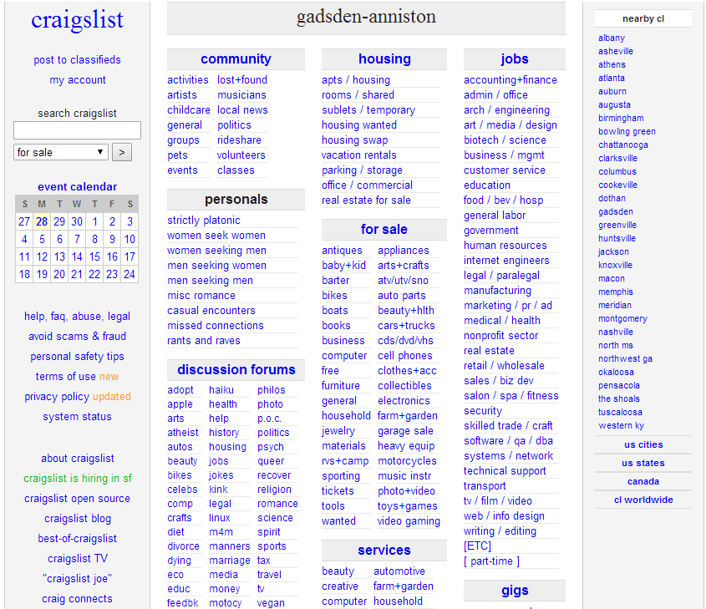
Craigslist online classified ads is…
 | Ubiquitous in US cities Ugly, but easy to use Low bandwidth (this still matters in some countries!) Multi-purpose: buy/sell an item, find a date, rent an apartment, hire a painter Free and open

Slide 9
…so I built one

Slide 10
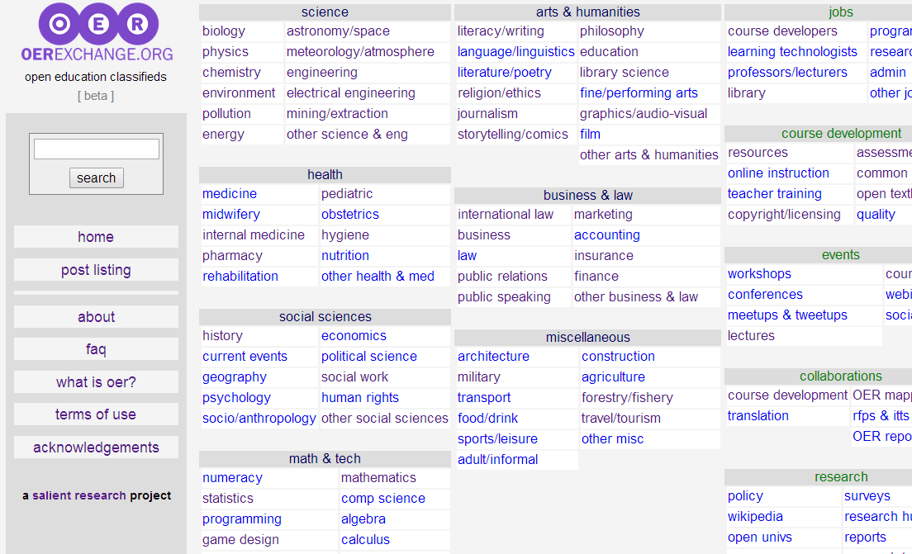
OER Exchange: free & open classifieds for OER
http://oerexchange.org/ (oerx.org)
Built by Salient Research
Has RSS feed and can scrape other RSS feeds
Low-bandwidth, simple, free and open
Searchable listings never expire, just lose priority
Anonymously post something or answer someone else’s post

Slide 11
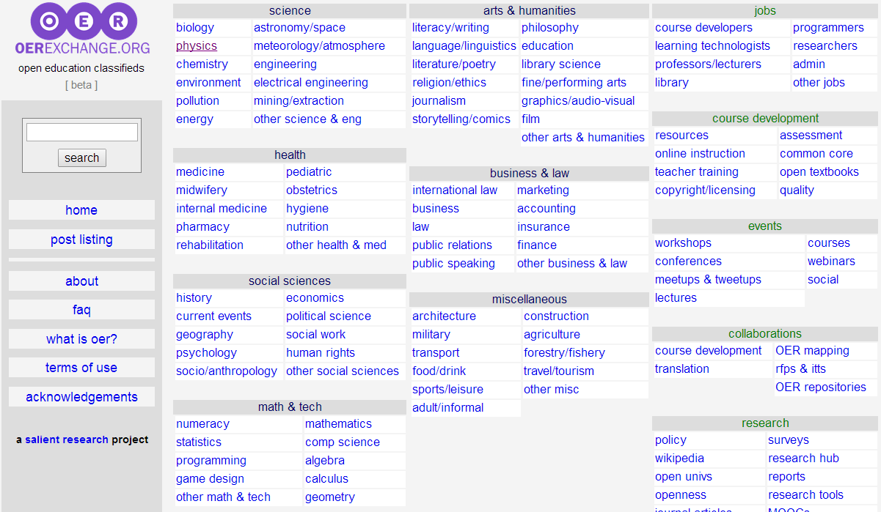

Slide 12
What would someone post?
“Has anyone found good post-graduate astronomy resources?”
“I don’t understand ‘open licensing’. What should I read?”
“Check out this cool biology video I made with my grade 8 students!”
“I’m running an OER workshop in Kenya in 2016. Here’s the link.”
“I’m a researcher studying OER use in British universities. Could you please take my survey?”
“I need Arabic language resources. Where should I look?”

Slide 13
Feedback please!
Please visit http://oerexchange.org/ (oerx.org)
Post something you want to share, and/or want to find – or answer a question!
Share the URL with others in OER
Email/tweet your feedback/ideas for new categories, terminology tweaks, etc.

Slide 14
Thank you! Feedback? Questions?
This presentation:
OERX: http://oerexchange.org/ (oerx.org)
Sara Frank Bristow | Salient Research | @salientresearch
sara@salientresearch.net

